Slide 1
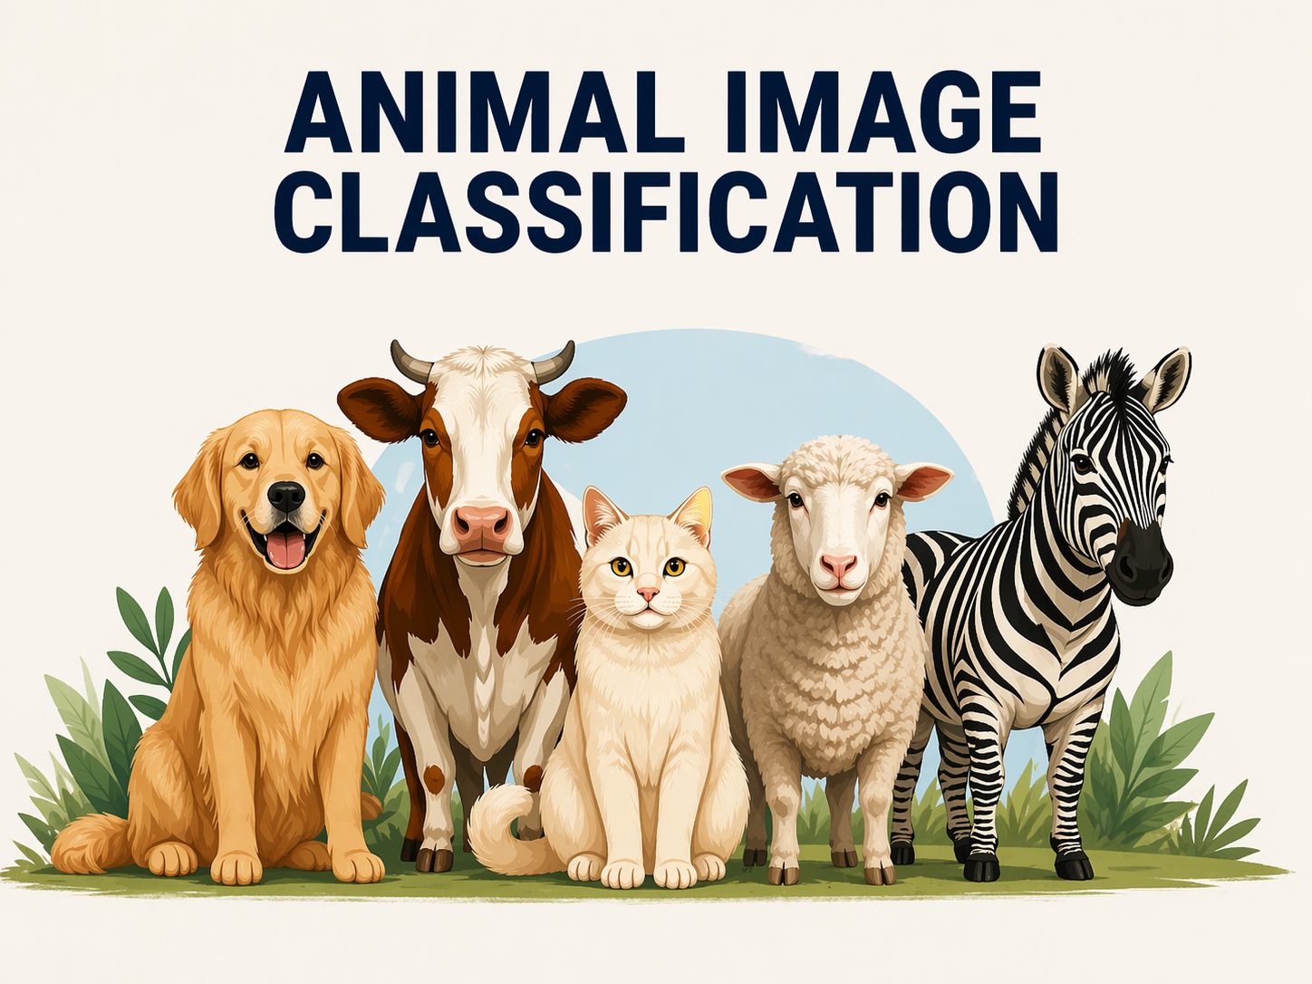

Slide 2
Group members
Shahriar Swanon (2231540642)
Md. Abu Sufian Protik (2312234042)
Khandakar Atikur Ahsan (2222120642)
Md. Faiaz Bin Hayder (2222629042)

Slide 3
Dataset
Cat – 111 images
Cow – 101 images
Dog – 105 images
Lamb – 107 images
Zebra – 108 images

Slide 4
Models
SVM
Logistic regression
Random forest
KNN

Slide 5
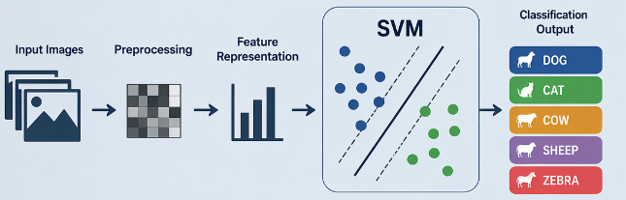
Support vector machine (SVM)
We used SVM because it performs well on small datasets and high dimensional data.
It can model non-linear decision boundaries using kernel functions.
HOG feature extraction was used to provide meaningful input features for the model.
However, due to limited dataset size, the model shows overfitting and the model achieved around 59% test accuracy.

Slide 6
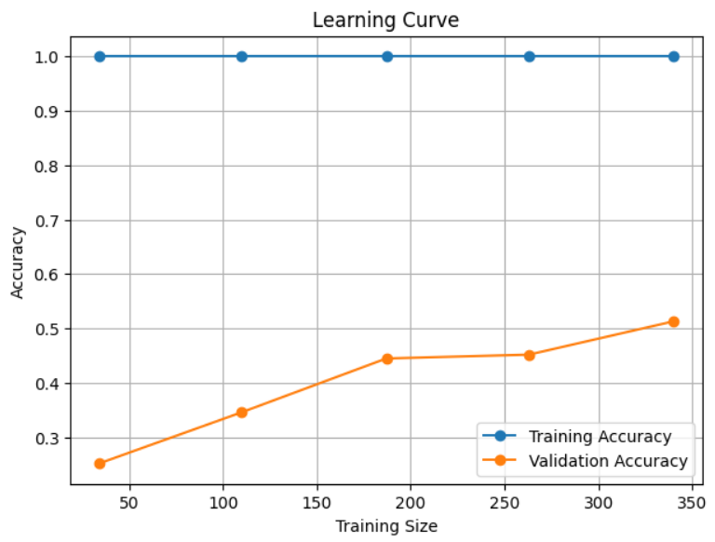
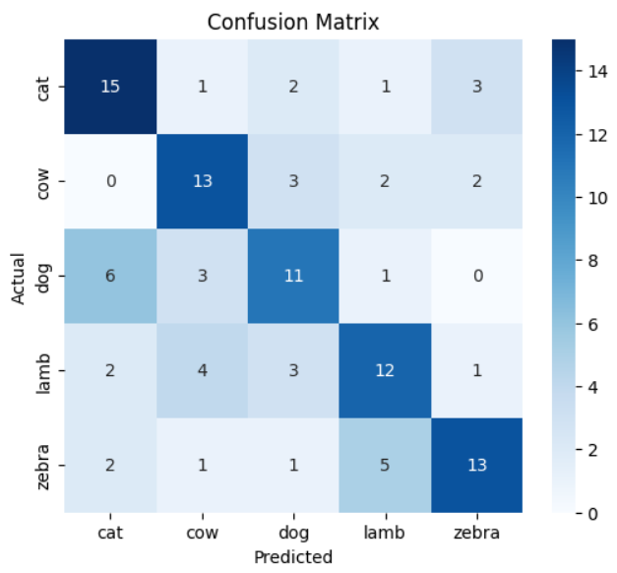
Learning curve and Confusion Matrix

Slide 7
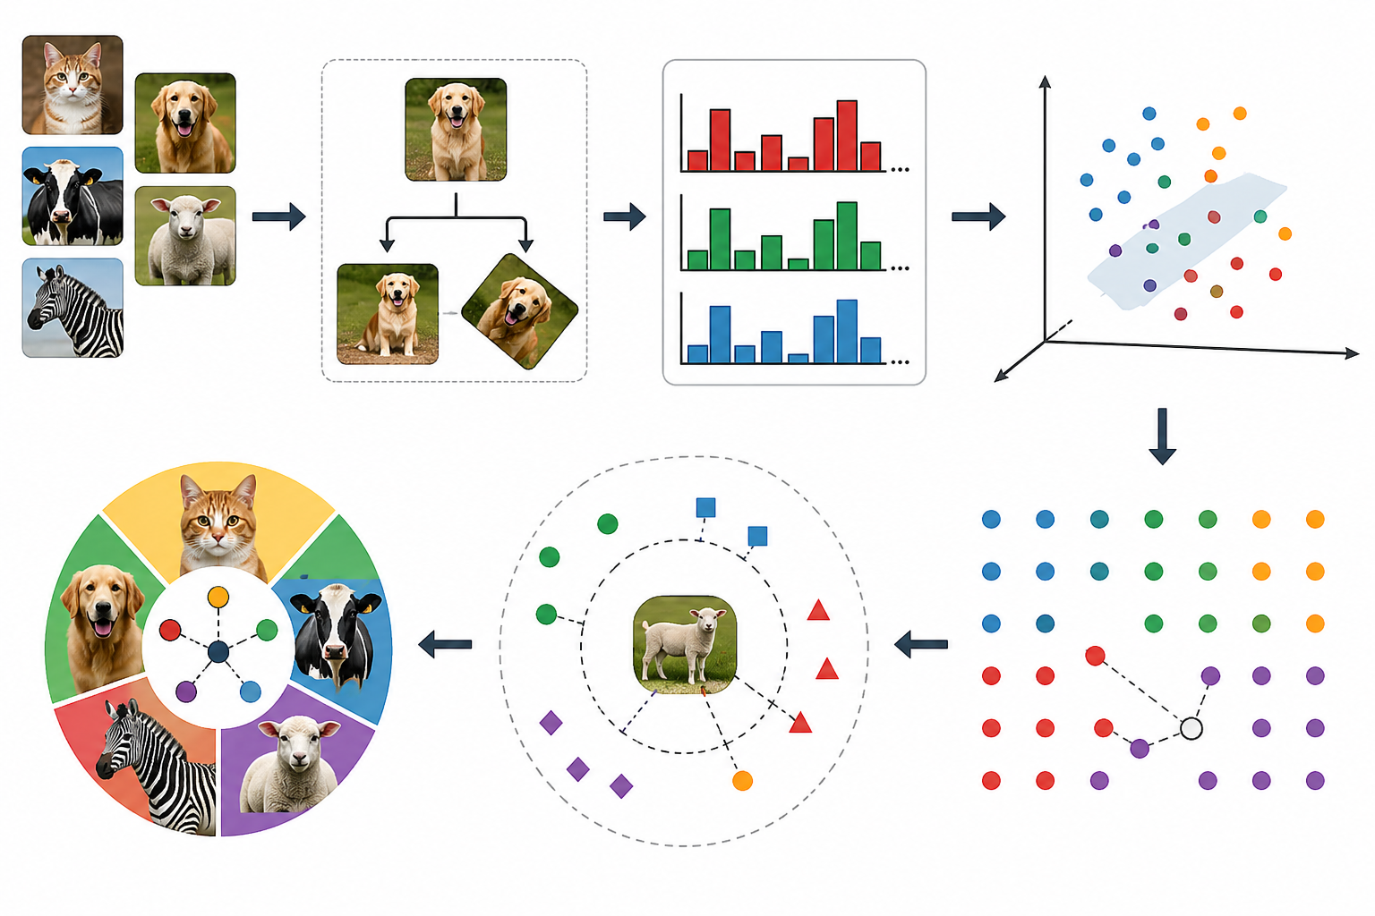
K-Nearest Neighbors (KNN)
Chosen for its simplicity and interpretability
Effective for multi-class image classification with extracted features
Non-parametric and works well with color histogram features
Used RGB color histograms (32 bins per channel → 96 features per image)
Features normalized via standardization
Applied PCA to reduce dimensionality while retaining 85% variance (reduced from 96 to 19 dimensions)

Slide 8
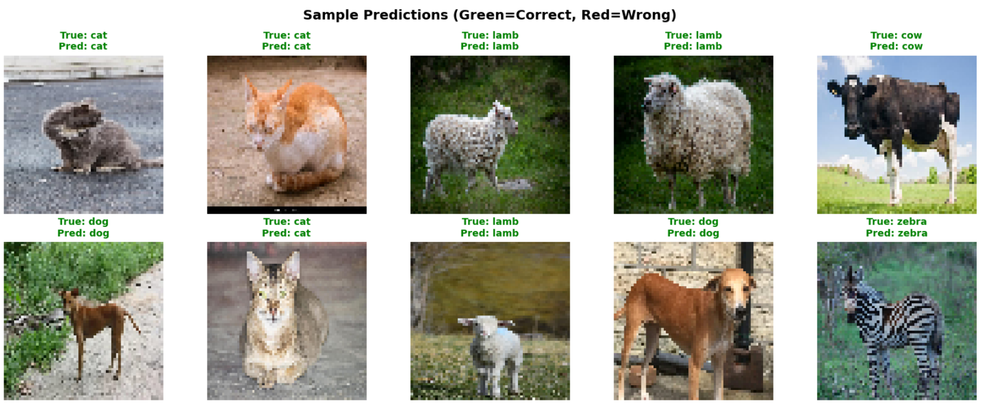
Results

Slide 9
Results
Overall accuracy 93.67%
Animal Name | Precision | Recall | F1
Cat | 96.43 | 94.74 | 95.58
Cow | 100.00 | 96.00 | 97.96
Dog | 91.80 | 87.00 | 89.60
Lamb | 91.80 | 96.55 | 94.12
Zebra | 90.54 | 94.37 | 92.41

Slide 10
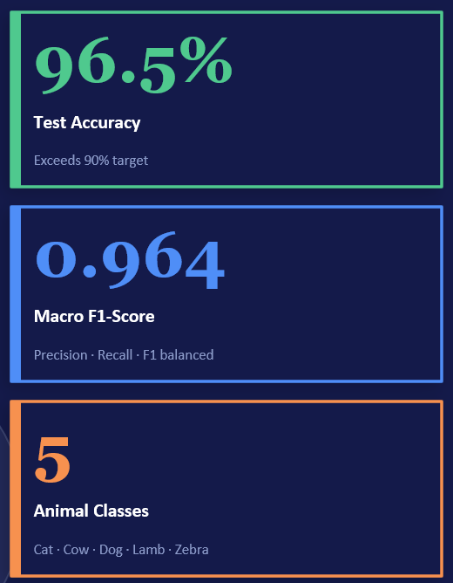
Logistic Regression
A 5-class animal image recognition system built with transfer learning. MobileNetV2 (pretrained on ImageNet) extracts 1,280-dimensional feature vectors from each image. A Logistic Regression classifier is then trained on those features, achieving 96.5% test accuracy across cat, cow, dog, lamb, and zebra classes.

Slide 11
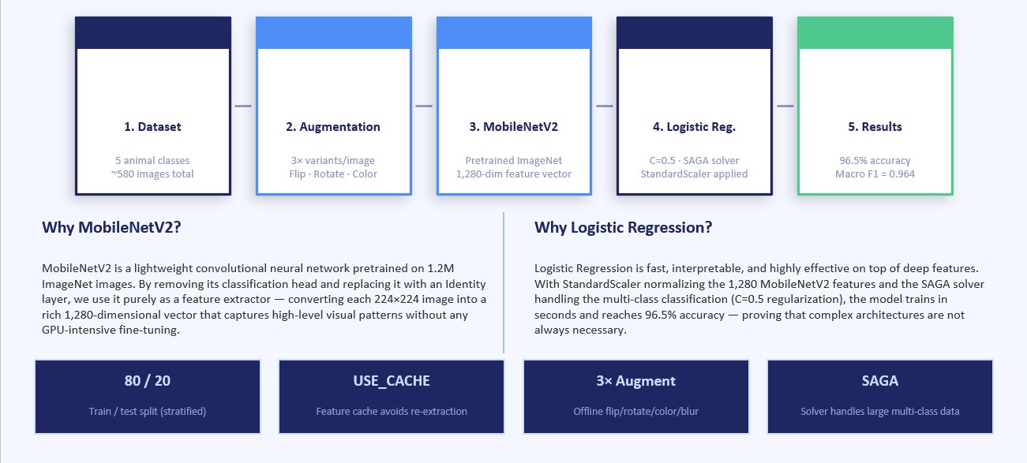
Pipeline architecture

Slide 12
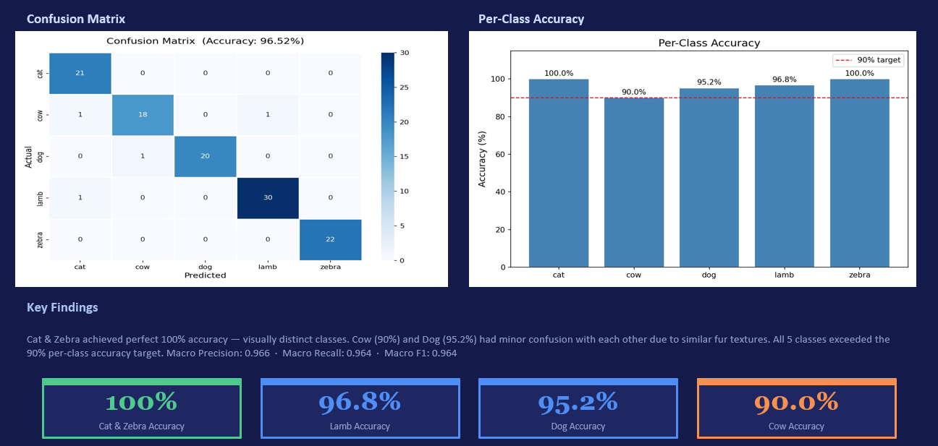
Results and performance

